Slide 1
This is a story about counting to four.
It’s also a story about sportsmanship.
Nikhil Chinchalkar

Slide 2
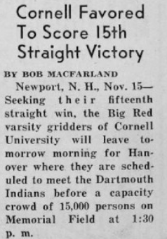

It’s November 15th, and Cornell is playing Dartmouth tomorrow.
Cornell was coming into the matchup off a 15-game winning streak, whereas Dartmouth was a meager 3-4.
November 16th, 1940
The Cornell Daily Sun
Ithaca, New York

Slide 3
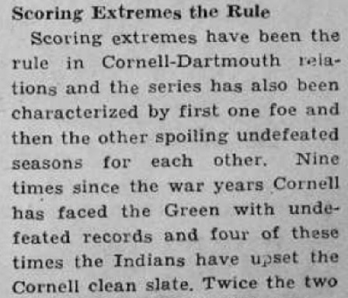
The Dartmouth vs. Cornell rivalry always produced some drama, with Dartmouth ruining Cornell’s undefeated record 4 times entering today.
November 16th, 1940
The Cornell Daily Sun
Ithaca, New York

Slide 4
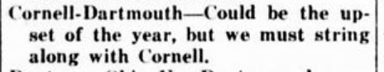
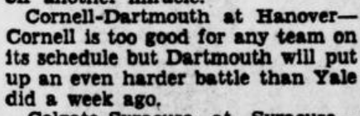
Still, most people thought Cornell would roll through Dartmouth.
If Dartmouth were to win, people would’ve called it the upset of the year.
November 14th, 1940
The Potters Herald
East Liverpool, Ohio
November 15th, 1940
Evening Star
Washington, D.C.

Slide 5
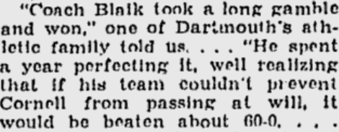
Yet, when the game actually commenced, Cornell’s offense was stuck.
Dartmouth’s head coach, Earl Blaik, gambled against the Cornell stout passing offense, and won.
November 19th, 1940
The Day
New London, Connecticut

Slide 6
Yet, when the game actually commenced, Cornell’s offense was stuck.
Dartmouth’s head coach, Earl Blaik, gambled against the Cornell stout passing offense, and won.
November 19th, 1940
The Day
New London, Connecticut

Slide 7
It’s now fourth and goal. This is it. This one play will decide the game.
INSERT PLAY HERE
The QB rolls out, jumps, and throws into the endzone … incomplete.

Slide 8
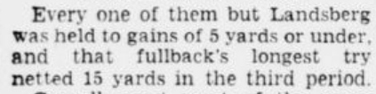
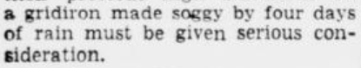
The field conditions limited the Cornell rushing attack, since four days of rain prior to the game made the field too soggy for the players.
In fact, through the whole game, Cornell only had one rush of over 5 yards.
November 17th, 1940
Evening Star
Washington, D.C.

Slide 9
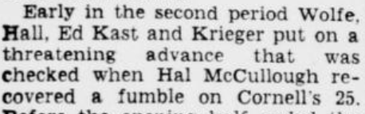
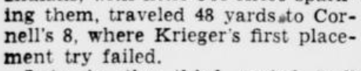
November 17th, 1940
Evening Star
Washington, D.C.
Really, the whole game was sloppy, with players fumbling the ball and kickers missing 25-yard field goals.

Slide 10
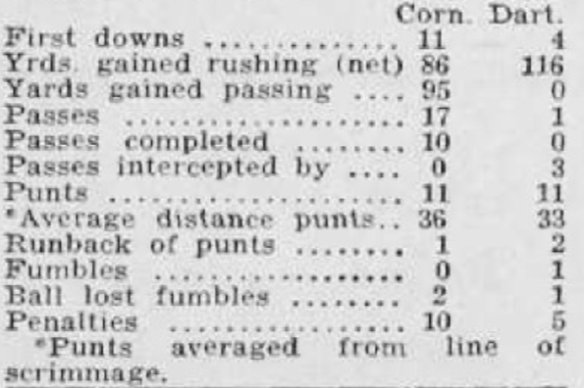
November 18th, 1940
The Cornell Daily Sun
Ithaca, New York
Keep in mind that this is 1940, so Dartmouth has 0 passing yards and only 1 passing attempt, too.
If you watched this game today, it would be the worst football game you would have ever seen.

Slide 11
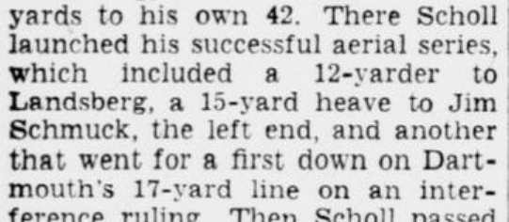
Or it would’ve been, until three minutes in the 4th quarter. Now, it’s 0-3 with Dartmouth up.
At that point, Cornell completed a 3 passes in a row, a 12-yarder, 15-yarder, and a 17-yarder.
November 17th, 1940
Evening Star
Washington, D.C.

Slide 12
Finally, Cornell completed a 10 yard pass to get to the Dartmouth 6-yard line. There’s just a few moments left in the game.
INSERT PLAY HERE

Slide 13
It’s first and goal. Cornell rushes right up the gut to the 3-yard line.
INSERT PLAY HERE

Slide 14
Second and goal. A run up the middle again - this time for two yards.
INSERT PLAY HERE
They’re now just 1 yard away from keeping their 15-game win streak alive.

Slide 15
Third and goal. Time’s winding down, and Cornell decides to pass this time.
INSERT PLAY HERE
It’s another run up the middle for no gain.

Slide 16
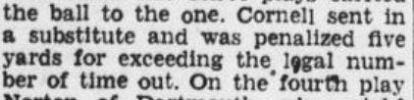
The referee, Red Friesell, gives a penalty, moving the ball back to the 6-yard line.
As time winds down, Cornell’s head coach, Carl Snavely, errs in taking a timeout he doesn’t have.
November 18th, 1940
The Waterbury Democrat
Waterbury, Connecticut.

Slide 17
It’s now fourth and goal. This is it. This one play will decide the game.
INSERT PLAY HERE
The QB rolls out, jumps, and throws into the endzone … incomplete.

Slide 18
Anyway, the referees confer, and give the ball back to Cornell at the 6.

Slide 19
What? That was fourth down, the ball should be with Dartmouth and the game should be over.

Slide 20
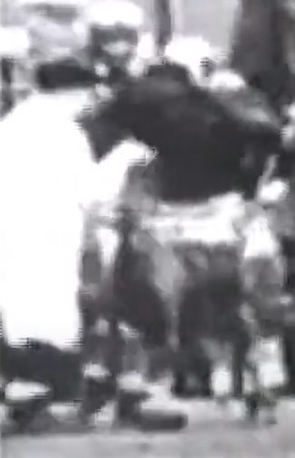
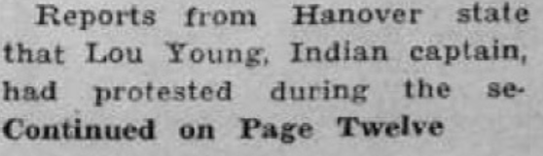
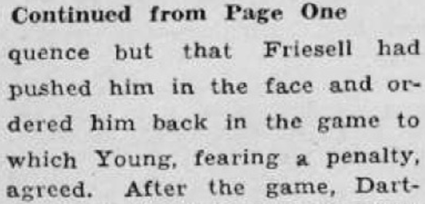
Dartmouth protests, but the referees aren’t budging.
November 16th, 1940
The Cornell Daily Sun
Ithaca, New York

Slide 21
Regardless, here’s Cornell at the 6 once more, on a fifth down?
INSERT PLAY HERE
The run the same play as before, but actually score this time.

Slide 22
Cornell just won on a non-existent fifth down and the referees don’t know it.
The fans, players, and coaches do, though, so Cornell issues a statement.

Slide 23
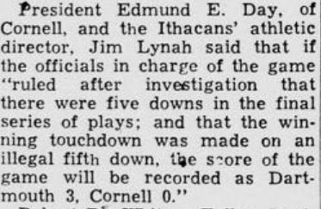
November 18th, 1940
The Wilmington Morning Star
Wilmington, North Carolina

Slide 24
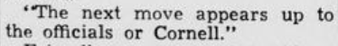
Dartmouth’s athletic publicity director put it simply:
November 18th, 1940
The Wilmington Morning Star
Wilmington, North Carolina

Slide 25
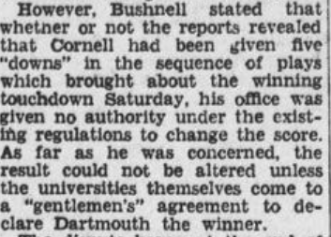
However, Asa Bushnell, the executive director of the Eastern Intercollegiate association, was quick to point out that he had no authority over the game, now that it had concluded.
November 18th, 1940
The Waterbury Democrat
Waterbury, Connecticut
It was clear, to resolve the situation, Cornell themselves would have to admit defeat.

Slide 26
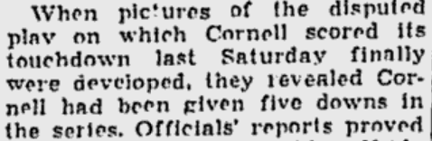
After the film of the game developed, it was clear to all: Cornell won the game on an illegitimate fifth down.
November 19th, 1940
The Day
New London, Connecticut

Slide 27
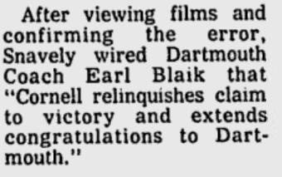
Following this revelation, Cornell did the unthinkable. They conceded the game.
July 13, 1975
The Tuscaloosa News
Tuscaloosa, Alabama

Slide 28
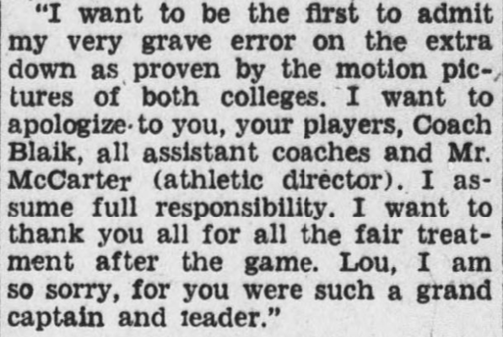
As Dartmouth accepted Cornell’s defeat, the head referee, Red Friesell issued a statement:
November 19th, 1940
The Waterbury Democrat
Waterbury, Connecticut

Slide 29
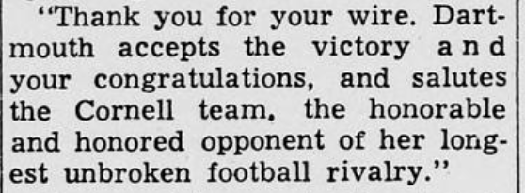
Dartmouth accepted Cornell’s defeat.
November 19th, 1940
The Wilmington Morning Star
Wilmington, North Carolina

Slide 30
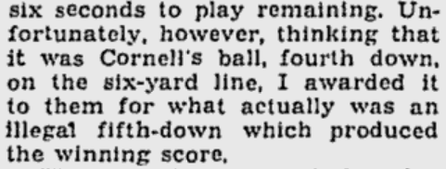
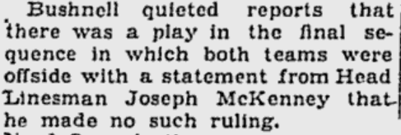
There were rumors that Friesell might’ve called phantom offsetting offsides penalties on 4th down to continue the game, but the reality was much simpler: he just messed up counting to 4.
November 19th, 1940
The Day
New London, Connecticut

Slide 31
This error and the consequent conceding telegrams were, and still are, unprecedented.
INSERT ARTICLE HERE
Notes:
Find account for NYT https://www.nytimes.com/1940/11/19/archives/dartmouth-3-cornell-o-official-score-as-ithacans-refuse-victory.html

Slide 32
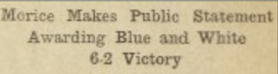
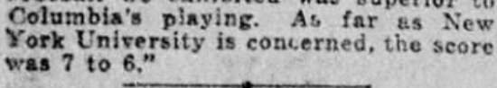
In fact, in 1922, a similar situation happened, with Columbia and New York University, where a safety was mistakenly called a touchdown, and reversed post-game.
October 25th, 1922
Columbia Daily Spectator
New York, New York
In this case, the two schools accepted different results, both claiming victory.
October 25th, 1922
New York Tribune
New York, New York
Notes:
Find account for NYT https://www.nytimes.com/1940/11/19/archives/dartmouth-3-cornell-o-official-score-as-ithacans-refuse-victory.html

Slide 33
Cornell’s humility was never-seen-before, and will likely never be replicated again.
While they may have lost the game, their honesty is what makes the contest so memorable.
Had they won, the game would have likely been forgotten.
Notes:
Find account for NYT https://www.nytimes.com/1940/11/19/archives/dartmouth-3-cornell-o-official-score-as-ithacans-refuse-victory.html

Slide 34
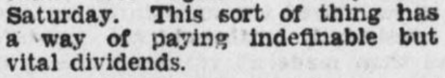
In an article published just three days after the events transpired, the author wrote:
They were referencing receiving good karma for the following week’s game against Penn.
November 19, 1940
The Waterbury Democrat
Waterbury, Connecticut
Notes:
Find account for NYT https://www.nytimes.com/1940/11/19/archives/dartmouth-3-cornell-o-official-score-as-ithacans-refuse-victory.html

Slide 35
But over 84 years later, their statement still holds true.
Notes:
Find account for NYT https://www.nytimes.com/1940/11/19/archives/dartmouth-3-cornell-o-official-score-as-ithacans-refuse-victory.html

Slide 36
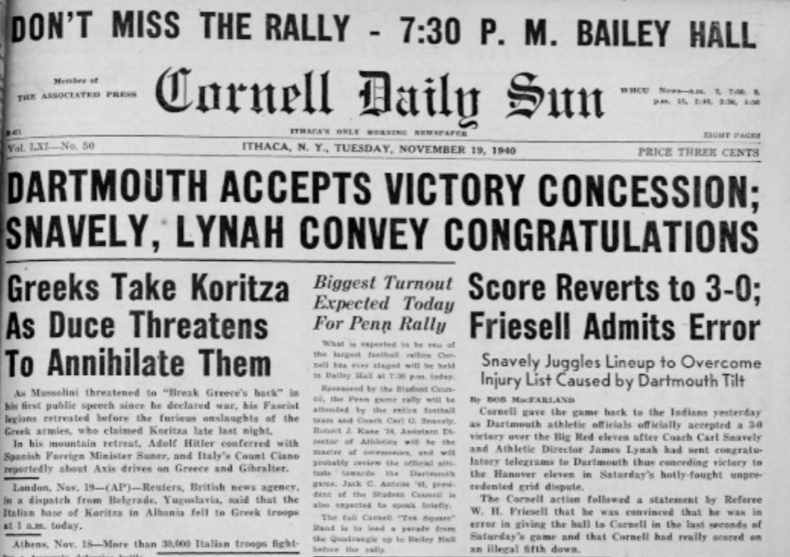
Big Red Sports Network
Library of Congress
newspapers.com
Google News Archive
Nikhil Chinchalkar
2024
Inspired by 17776
Notes:
Find account for NYT https://www.nytimes.com/1940/11/19/archives/dartmouth-3-cornell-o-official-score-as-ithacans-refuse-victory.html

Slide 37
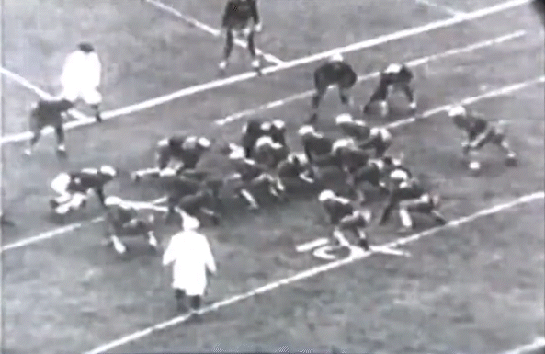
This is an example of a GIF that would show a play.
1st and Goal at the Dartmouth 6 yard line

